Slide 1
Voice based Information Retrieval System in Hindi- HinSearch
Mentor: Dr. Sukomal Pal
By-
Kshitij Jolly
Ankit Kumar Mishra
Kinshuk Yadav

Slide 2
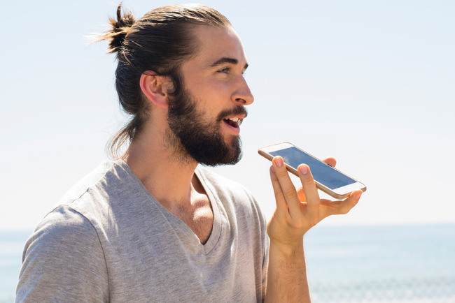
Our Objective
To provide an application in which the user provides input in voice form in Hindi and retrieves the result in speech form in Hindi without any kind of internet connectivity.

Slide 3

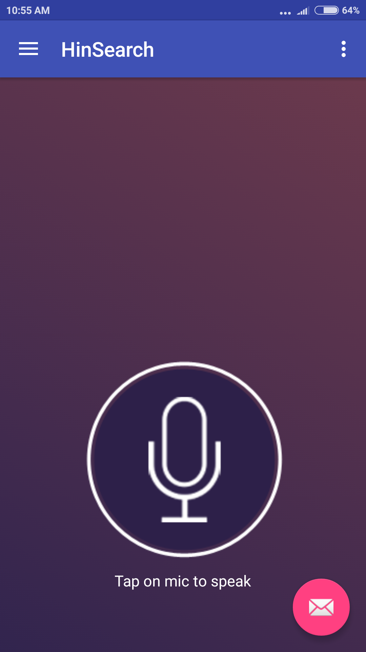

Can’t type?
Don’t know English???

Slide 4
Voice Recognition
CMU Sphinx | Google Speech Recognition:
Components-
Acoustic Model
Phonetic Dictionary
Language Model

Slide 5
AM Trainer
LM Trainer
Acoustic
Model
Language
Model
Acoustic Signal
Speech
Recognizer
Word Sequence

Slide 6
What it means to software
We need to represent and estimate parameters of the acoustic model
We need to represent and estimate parameters of the language model
Given the models, we need to search through all possible word sequences. Or decoding

Slide 7

Why Google Speech Recognition?
Google
Larger and better language and acoustic models
Online support by Google
Easily compatible with Android

Slide 9
How does it work?
AM Trainer
LM Trainer
The Hinsearch app uses Google services to take speech input from the user in Hindi.
Then, it translates the Hindi text into English which is sent as a query to the server.
The server receives the query and extracts out the main words of the query and returns a brief description of the requested query in English.
This is again converted back to Hindi. Now when the user presses the “SPEAK” button, he is able to hear the description in Hindi.
Acoustic
Model
Language
Model
Acoustic Signal
Speech
Recognizer
Word Sequence

Slide 10
Further improvement required
We have to make the app respond to questions like “Belgium ki raajdhaani kya hai?” or “Aaj ka mausam kaisa hai?” which are some basic queries performed by assistants in English like Siri or Cortana.
We have to implement SMS based service of making the query to make most of the functionality of our app independent of internet connectivity.
We will send the query either to a server run by us or this step can be made to do by the service provider. This idea is being worked on.

Slide 11
Progress Report
We have Implemented the basic part of the project which was speech based information retrieval in Hindi.
We are running ahead of schedule in terms of implementing the basic functionality of the application. Now we look forward to building an end to end solution and build a sophisticated app.
We have to add features like machine learning and offline SMS based information retrieval to make the app better and attractive.

Slide 12
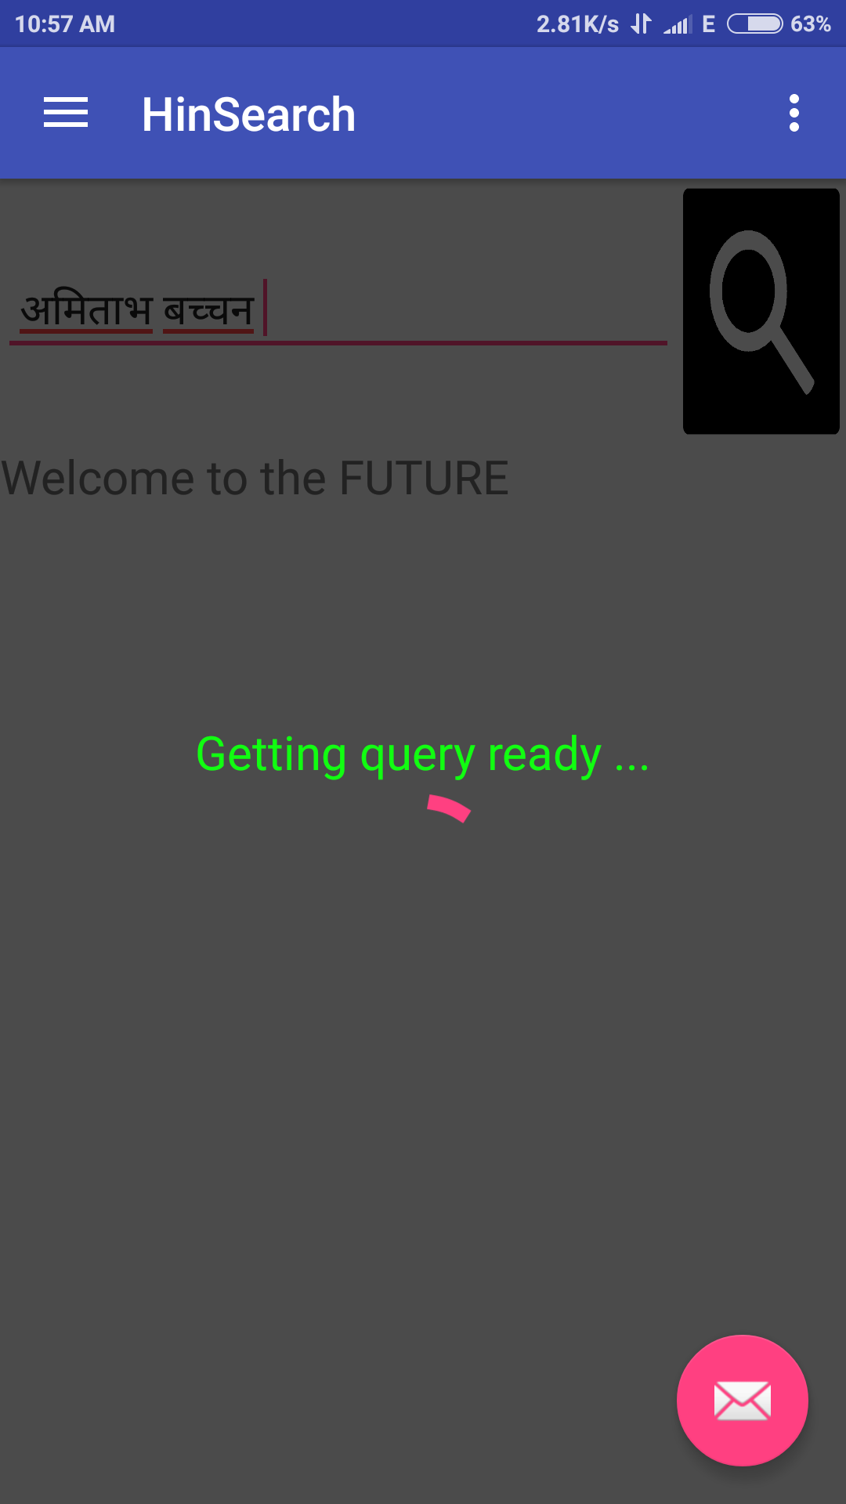

Slide 13
